Slide 1
How to Map a Network Printer

Slide 2
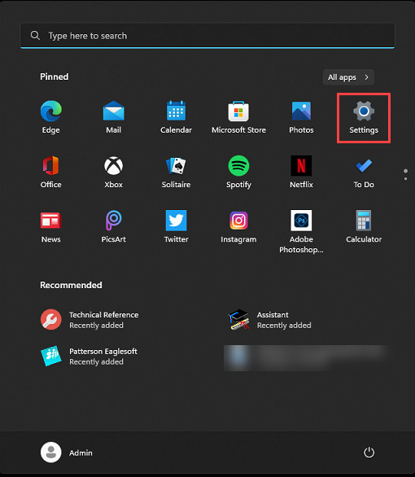
Open the Start Menu and select Settings.

Slide 3
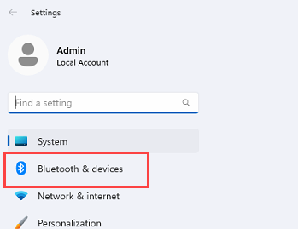
Select Bluetooth & devices.

Slide 4
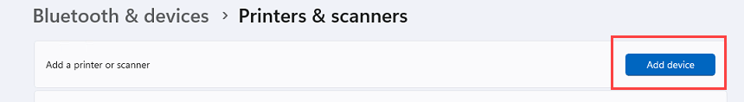
Select Printers & scanners. Next to Add a printer or scanner, select Add device.

Slide 5
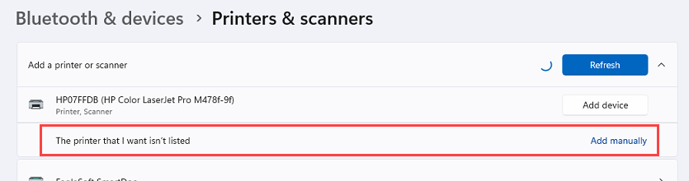
After Windows searches for connected devices for a while, the option The printer that I want isn't listed, select Add manually link next to this

Slide 6
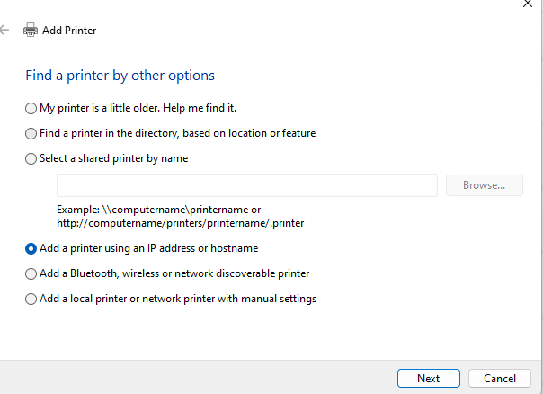
Click Add a printer using an IP address or hostname. Click Next.

Slide 7
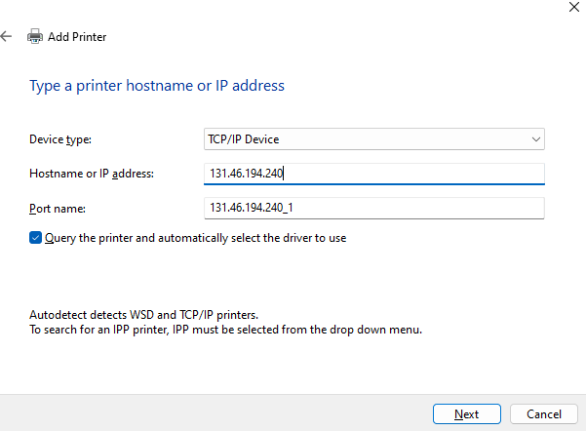
Change the Device type to TCP/IP. Type your printers IP address. Select next,

Slide 8
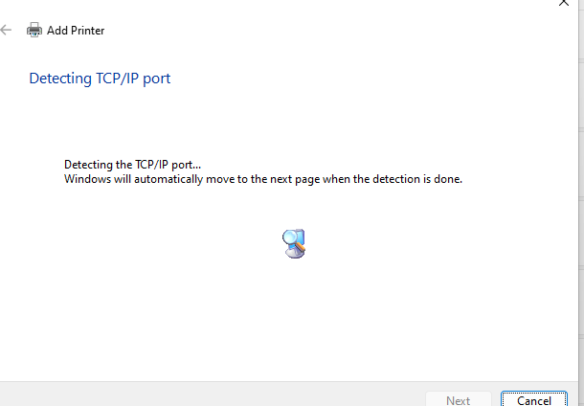
You will see this screen loading.

Slide 9
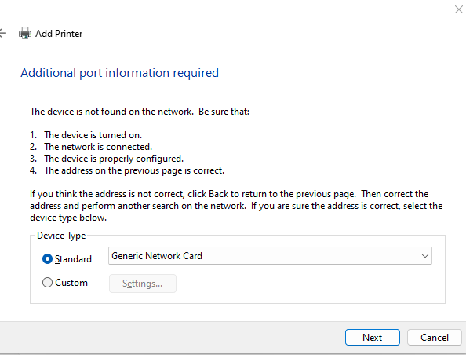
Select Next

Slide 10
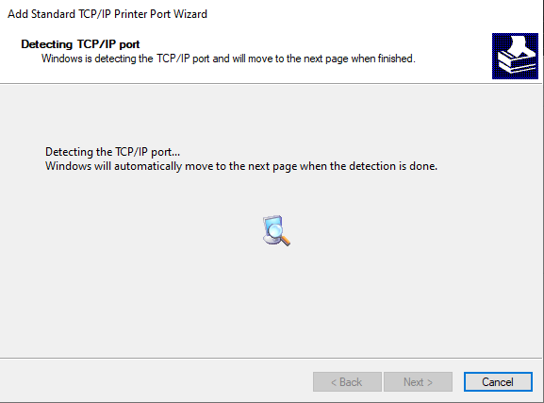
This screen will load for approx 1 minute

Slide 11
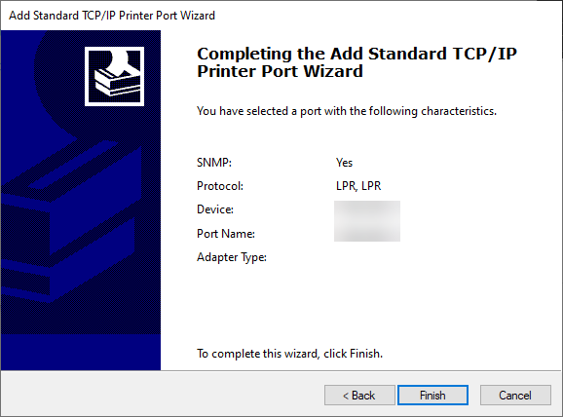
Click Finish.

Slide 12
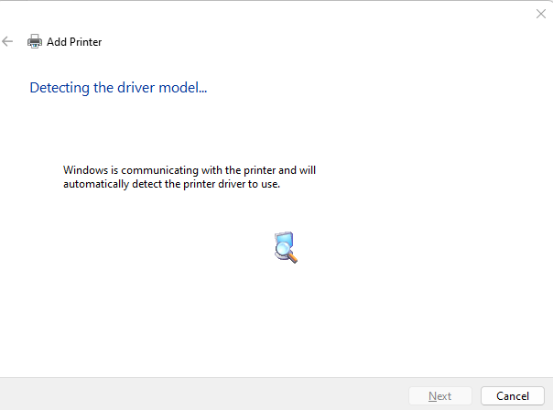
This screen will load for approx 1 minute

Slide 13
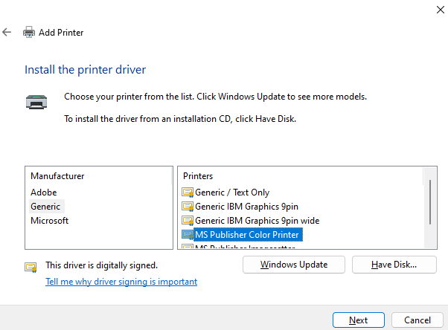
Select Generic and MS Publisher Color Printer. Select next.

Slide 14
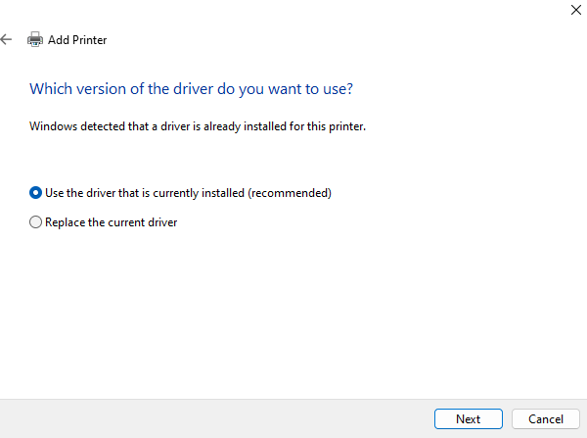
Select next

Slide 15
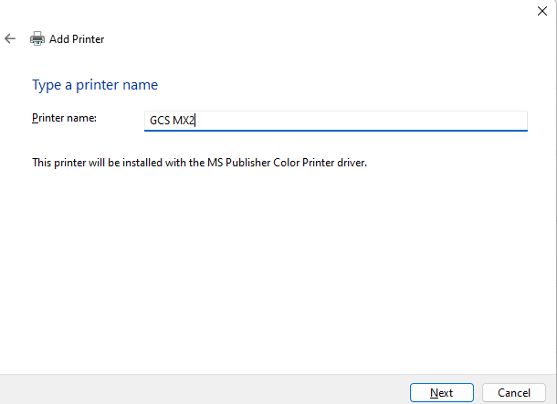
Name the Printer. Select next

Slide 16
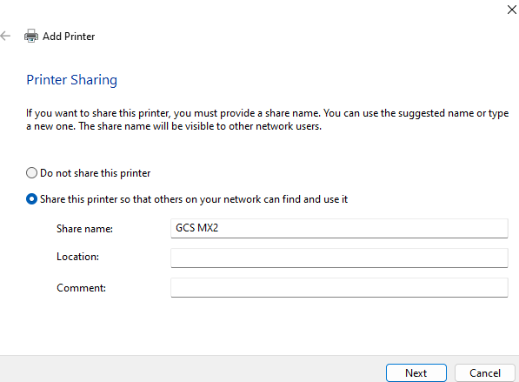
Select next

Slide 17
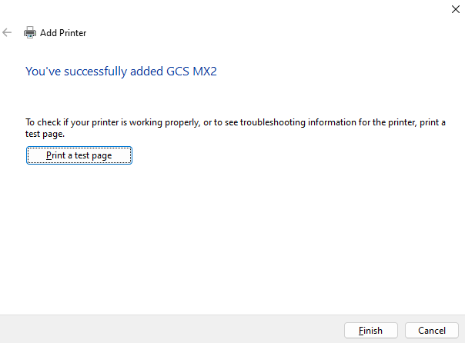
Print the test page and select finish

